Slide 1
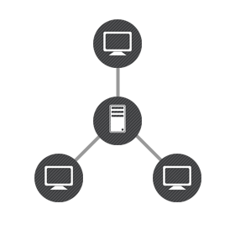
Parallel and DISTRIBUTED SYSTEMS
BY MBONABUCYA Celestin
Email: cembonace@gmail.com
Phone: 0788 69 58 62
School of ICT
College of Science and Technology
University of RWANDA

Slide 2
Module TITLE and ITS NAME
Module Code : CSC4263
Module Title : Parallel and Distributed Systems
Level : 5 Semester : 02 Credits : 10
First Year of Presentation :2015
Administering School : School of ICT

Slide 3
Learning OUtCOMES-1
  Parallel Systems
      Understanding and operating with parallel systems topics involving concepts, architectures and Programming models
  Distributed Systems
      Understanding and operating with distributed systems topics involving concepts, architectures and programming models.

Slide 4
Learning OUTCOMES-2
  Parallel and Distributed Algorithms
This course provides under graduate students in computer science with experience of parallel and distributed computing.
It gives an overview of parallel and distributed computers, and parallel computation.
The course addresses architectures, languages, environments, communications, and parallel programming.
Emphasis on understanding parallel and distributed computers and portable parallel programming .

Slide 5
Evaluations
TWO Assignment = 30 marks
ONE CAT=20 marks
ONE EXAM=50 marks
Total=100 Marks

Slide 6
What is Distributed system?-1
A distributed system is a collection of autonomous computing elements that appears to its users as a single coherent system.
This definition refers to two characteristic features of distributed systems.
  The first one is that a distributed system is a collection of computing elements each being able to behave independently of each other. A computing element, which we will generally refer to as a node, can be either a hardware device or a software process.
  A second element is that users (be they people or applications) believe they are dealing with a single system.

Slide 7
What is a distributed system?-2
Definition [Coulouris & Emmerich]
  A distributed system consists of hardware and software components located in a network of computers that communicate and coordinate their actions only by passing messages.
Definition [Lamport]
  A distributed system is a system that prevents you from doing any work when a computer you have never heard about, fails.
This means that one way or another the autonomous nodes need to collaborate

Slide 8
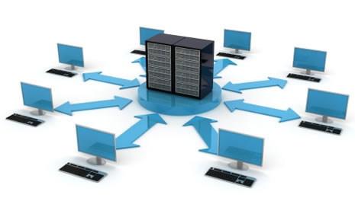
Example of a distributed system

Slide 9
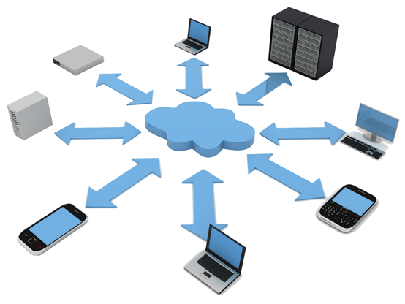
Example2

Slide 10
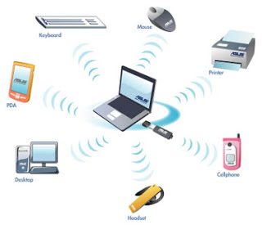
Example 3

Slide 11
Types of distributed system

Slide 12
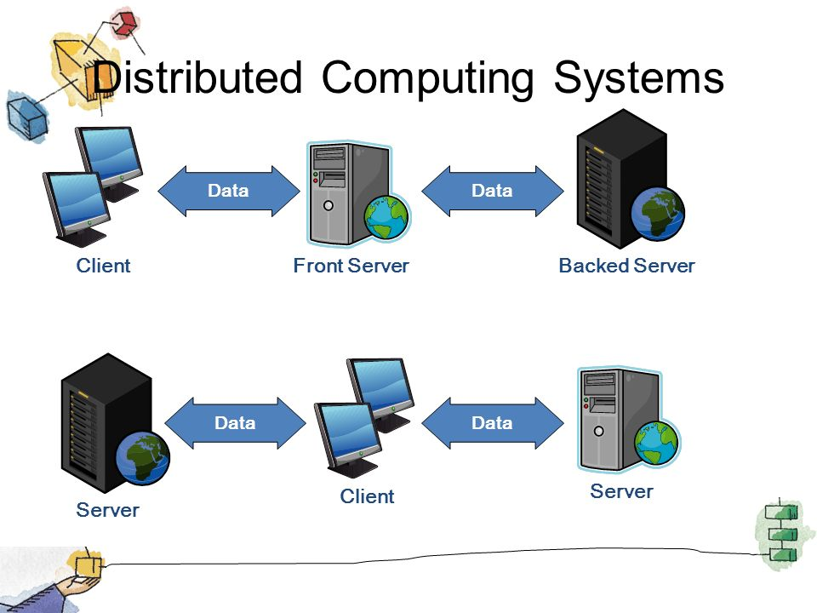
Distributed Computing Systems
Used for high performance computing tasks
Cluster computing systems
Grid computing systems

Slide 13
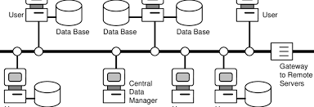
Distributed Information Systems
Systems mainly for management and integration of
  business functions
  Transaction processing systems
  Enterprise Application Integration

Slide 14
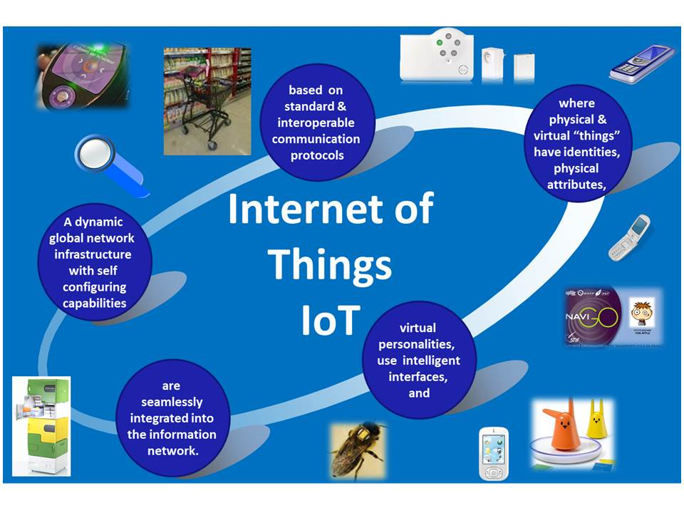
Distributed Pervasive Systems
Mobile and embedded systems
Home systems
Sensor networks

Slide 15
Requirements leading to distributed systems
Resource sharing
– the possibility of using available resources any where
Openness
– an open system can be extended and improved incrementally
Scalability
– serve more users, provide shorter response times
Fault tolerance
– maintain availability even when individual components fail
Heterogeneity
– network and hardware, operating system, programming
Languages, implementations by different developers

Slide 16
Implications of distributed systems
Independent failure of components
– “partial failure” & incomplete information
􏰁 Unreliable communication
– Loss of connection and messages. Message bit errors
􏰁 Unsecure communication
– Possibility of unauthorized recording and modification of messages
􏰁 Expensive communication
– Communication between computers usually has less bandwidth, longer latency, and costs more, than between independent processes on the same computer
􏰁 Concurrency
– components execute in concurrent processes that read and update
shared resources. Requires coordination 􏰁 No global clock
– makes coordination difficult

Slide 17
Resource sharing
The opportunity to use available hardware, software or data any where in the system
Resource managers control access, offer a scheme for naming, and controls concurrency
A resource manager is a software module that manages a resource of a particular type
A resource sharing model describes how
resources are made available
resources can be used
service provider and user interact with each other

Slide 18
Models for resource sharing
Client-server resource model
    Server processes act as resource managers, and offer services (collection of procedures)
    Client processes send requests to servers
Object-based resource model
    Any entity in a process is modeled as an object with a message
    based interface that provides access to its operations
    Any shared resource is modeled as an object

Slide 19
Openness
An open DS can be extended and improved incrementally
Requires a uniform IPC mechanism and publication of component interfaces (e.g., subject to standardization)
    Protocol specifications (www.ietf.org)
    OMG: interface specifications etc. (www.omg.org)
New components can be integrated with existing components

Slide 20
Concurrency
Components in DS execute in concurrent processes
Components access and update shared resources (e.g., variables, data bases, device drivers)
Integrity of the system may be violated if concurrent updates are not coordinated
Preservation of integrity requires concurrency control where concurrent access to the same resource is synchronized

Slide 21
Scalability
A system is scalable if it remains effective when there is a significant increase in the amount of resources and number of users
  Internet: no of users and services has grown enormously
  Scalability denotes the ability of a system to handle an
  Increasing future load
Requirements of scalability often leads to a distributed system architecture (several computers)

Slide 22
Failure handling
Hardware, software and network fail!!
DS must maintain availability even in cases where hardware/software/network have low reliability
Failures in distributed systems are partial
makes error handling particularly difficult
Many techniques for handling failures
Detecting failures (checksum )
Masking failures (retransmission in protocols, replication ...)
Tolerating failures (as in web-browsers)
Recovery from failures
Redundancy (replicate servers in failure-independent ways)

Slide 23
Heterogeneity
Variations and differences that must be handled in the network
The Internet-protocol is implemented over many different networks
Hardware
  difference in representation of data types on different processors
Operating system
  API to the same protocol and services varies
Programming languages
  different representation of character set and data structures
implementation by different developers
  ensure that different programs can communicate
  requires agreement on a number of things (cf. standards)

Slide 24
Summary
Distributed systems:
Hardware and software-components located in a network of computers that communicates and coordinates their actions exclusively by sending messages
Consequences of distributed systems
Independent failure of components
Unsecure communication
Requirements like resource sharing, openness, scalability, fault tolerance and heterogeneity can be satisfied by distributed systems
Distributed systems organized as middleware
Harvest potential advantages of distributed systems without having to pay for all their challenges and problems (transparency)

